Slide 1


Tutorial
The New Business Searching Interface
featuring:
connect.ebsco.com

Slide 2
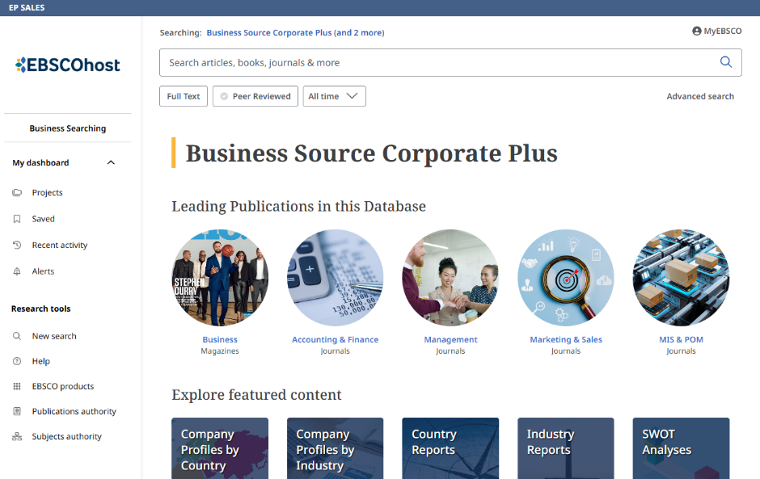
  The Business Searching Interface (BSI) is EBSCO's highly focused user interface created especially for the business searcher. BSI provides an easy way to browse and search for company profiles, industry information, country economic data, and market research. In this tutorial, we look at searching and browsing in the BSI.

Slide 3
  The Business Searching Interface supports the Business Source database product line. The specific database(s) being searched with the interface are displayed above the Search box on the Home screen. Click on the Logo in the upper left at any time to return to this screen.

Slide 4
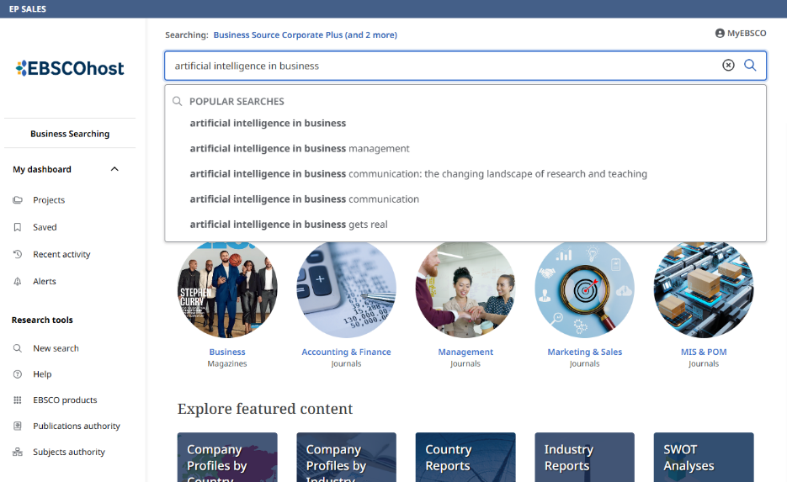
  We’ll begin by conducting a search from the Home screen. Enter your keywords in the search box. The Autocomplete feature will anticipate your search terms, so even if you misspell a word, relevant search terms will appear in the drop-down menu. Select from the list or finish entering your keywords, apply any desired limiters below the search box and click the Magnifying glass to generate a list of results.

Slide 5
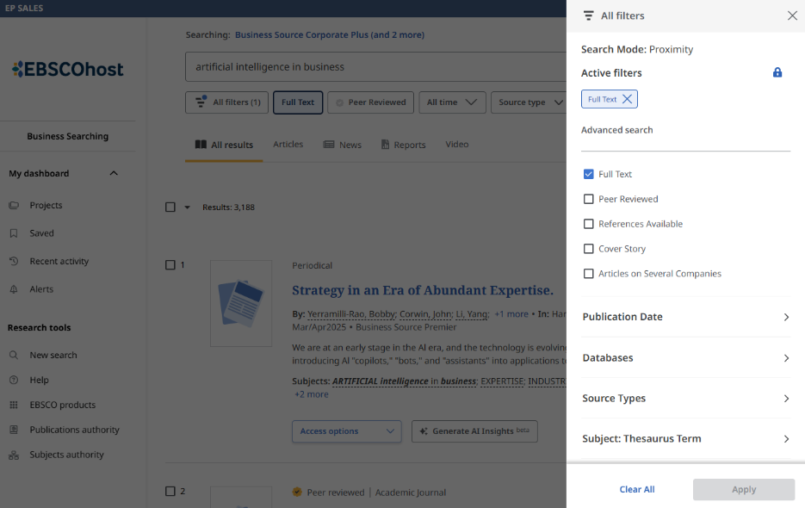
  On the result list, click the All filters button to view the available options to refine your search results. Make your selections and click Apply.

Slide 6
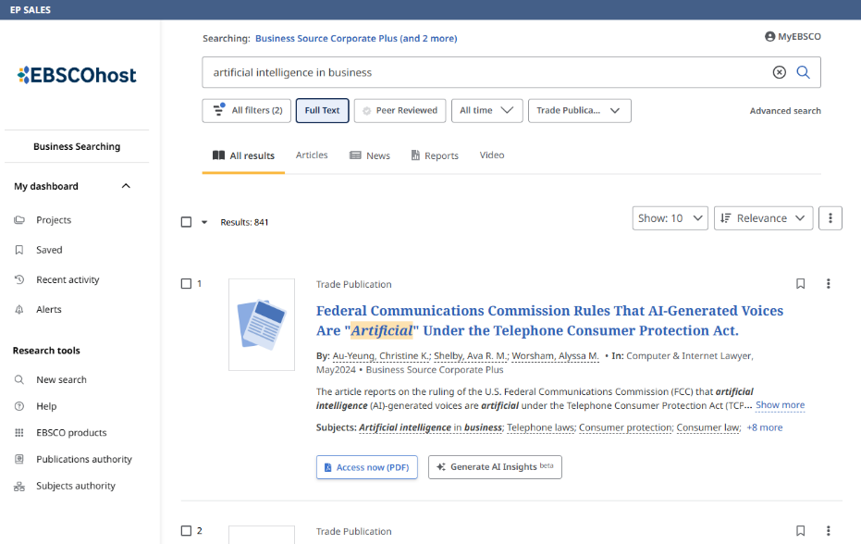
  Quickly filter results by Articles, News, Reports or Video using the buttons above the list. Click the Access button to read the full text of an article. Save articles to the dashboard by clicking the bookmark icon. To save them in your dashboard permanently, click the MyEBSCO link at the top of the screen to sign in your personal MyEBSCO account. If you do not yet have a personal account, you can also create one from here.

Slide 7
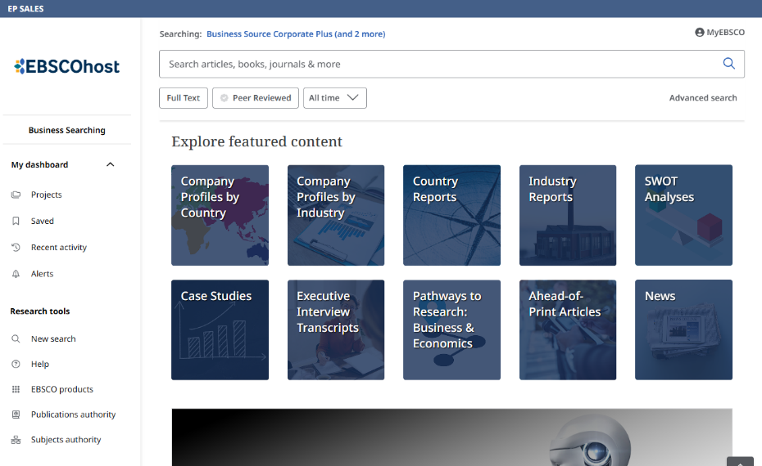
  In addition to searching, you can also browse for Company Profiles, Country and Industry Reports, SWOT analyses, and more under Explore featured content on the Home screen. In this example, we click to browse Company profiles by Industry.

Slide 8
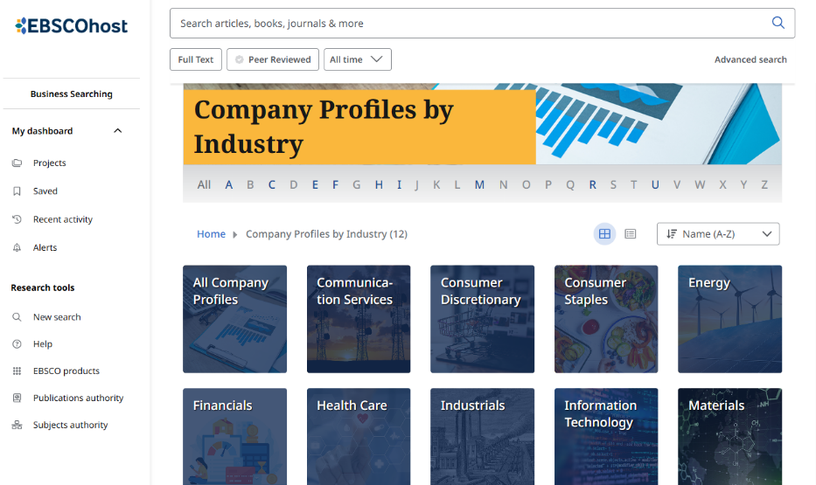
On the next browse page, click an industry to continue browsing. To switch the display of topics from a grid view to a list, click the list view icon.

Slide 9
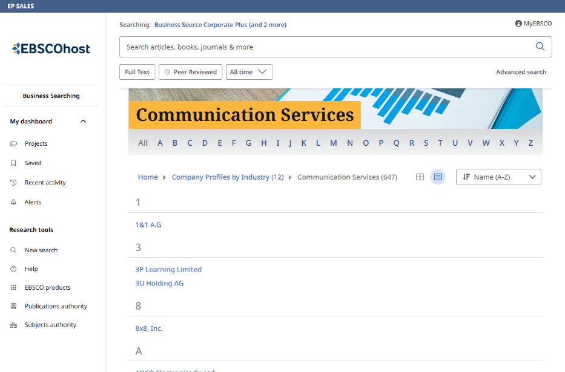
A list of companies for that industry is displayed. Click a letter to jump ahead in the alphabetical list of companies. Click a hyperlinked company name to view the available company profiles.

Slide 10
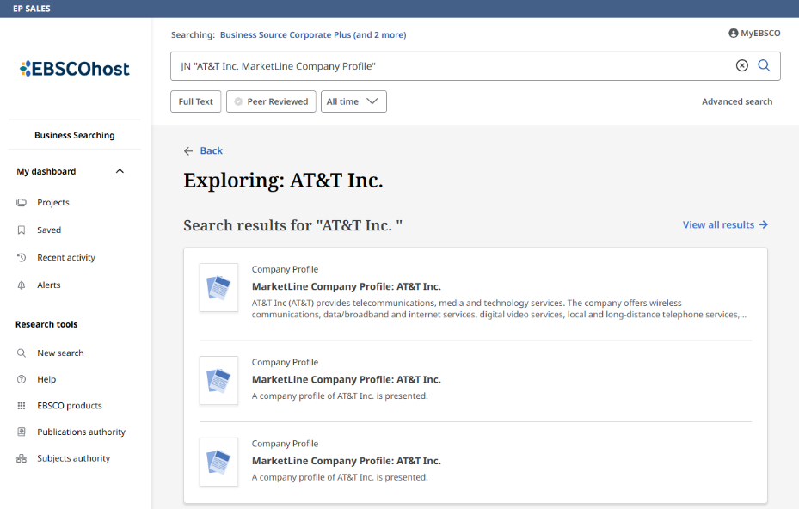
Click a MarketLine link to view more details or read the full text of a profile.

Slide 11
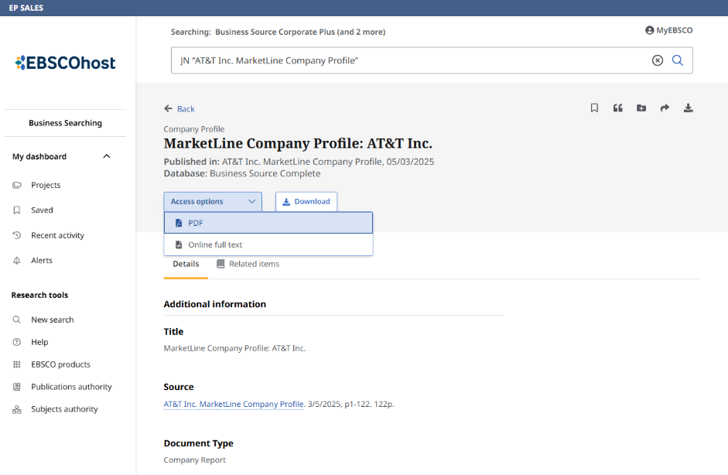
From the details page, click the Access options menu to read the profile or click the Download button to save it to your device.

Slide 12
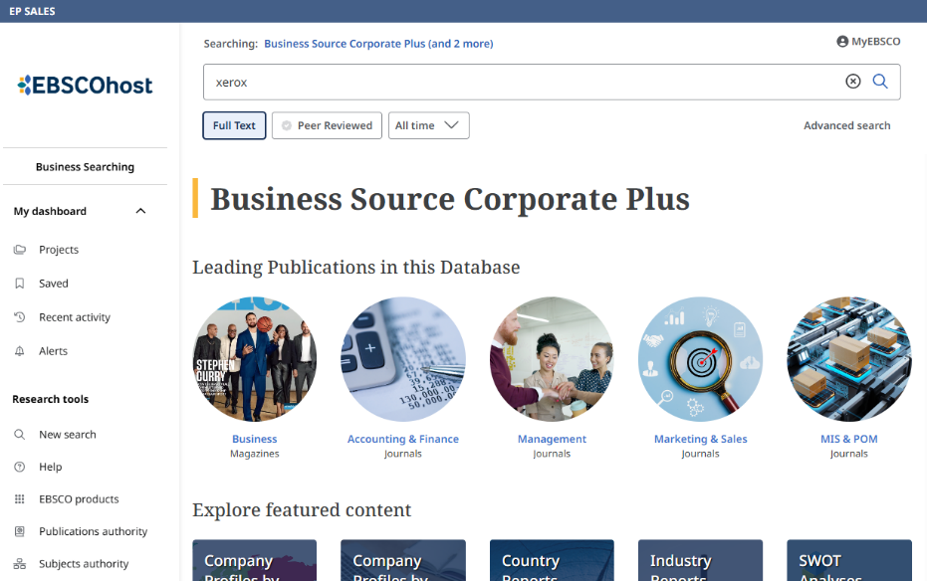
  You can also use the Business Searching Interface to search for certain types of documents, such as SWOT Analyses. In this example, we will search for a SWOT Analysis for Xerox, outlining the company’s strengths, weaknesses, opportunities and threats. From the Home screen, enter Xerox in the Search box, apply the Full Text limiter and click the magnifying glass.

Slide 13
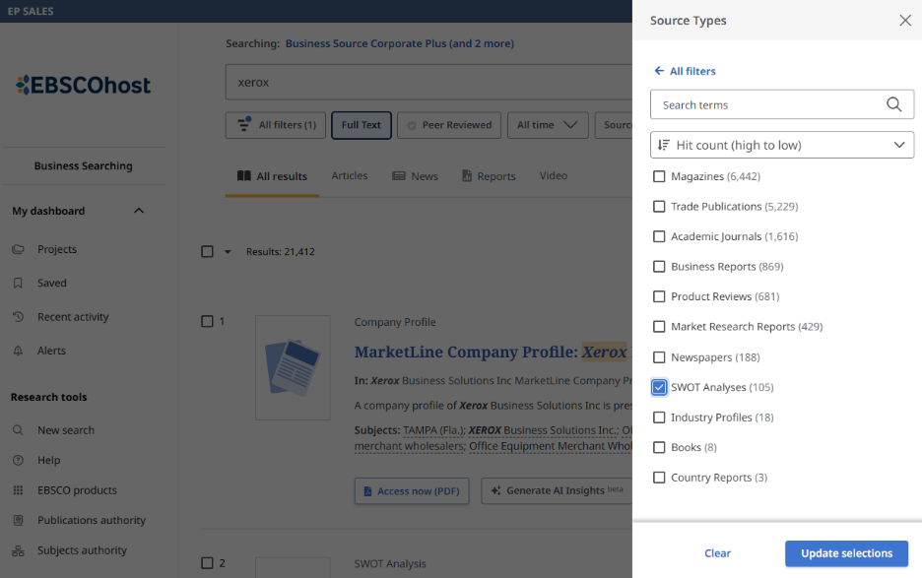
  On the result list screen, click the All filters button and scroll down to Source Types in the All filters panel. Under Source types, click the +more link and select SWOT Analyses. Click Update selections and then click Apply to view a result list limited to SWOT Analyses.

Slide 14
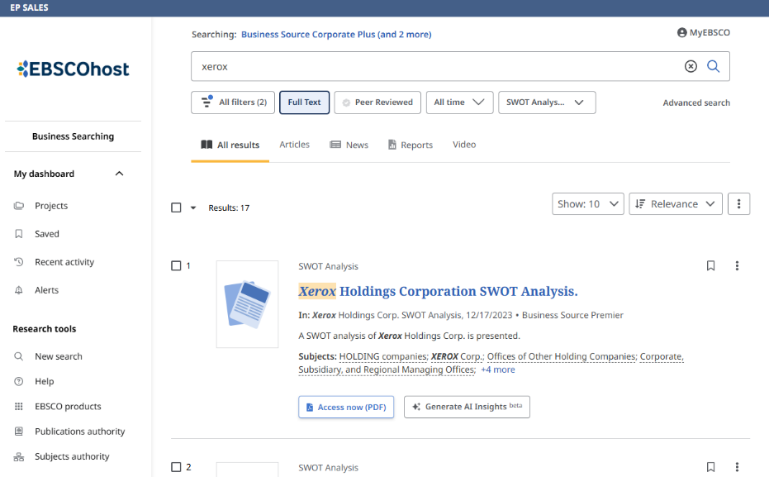
  Click on the Access button in the result list to read the SWOT Analysis.

Slide 15
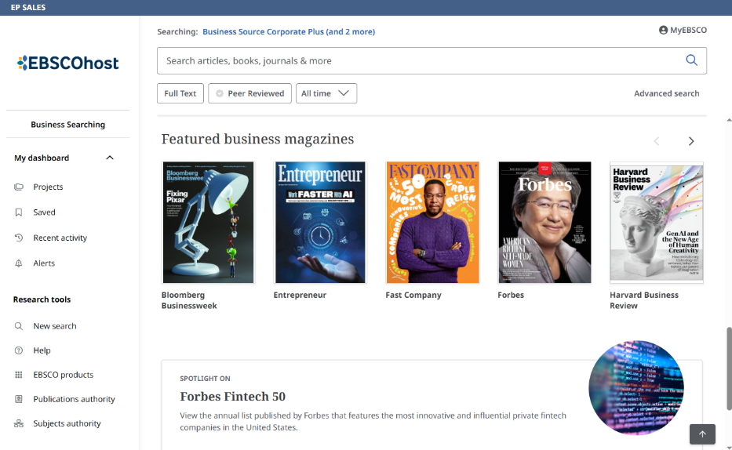
  Under Featured business magazines on the Home screen, click a magazine cover to view the title’s publication details and view articles from a specific issue.

Slide 16
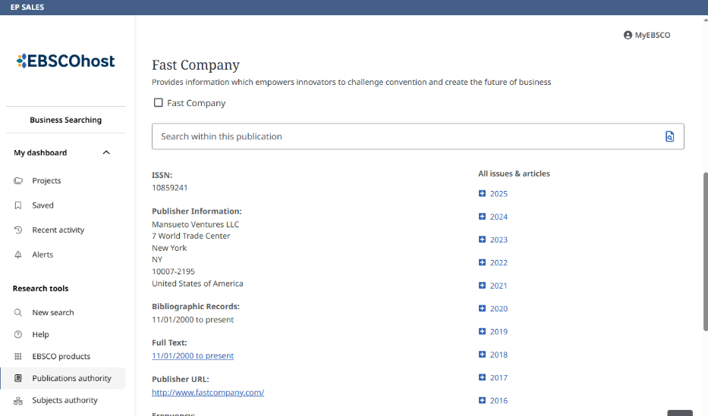
  On the Publication details screen, click a year and then select an issue to view the available articles in a result list.

Slide 17
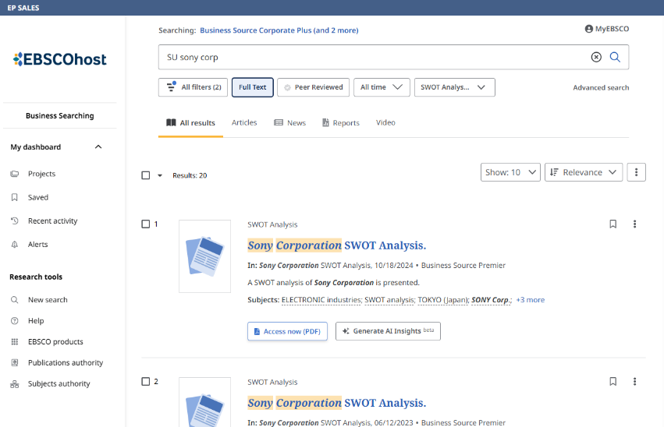
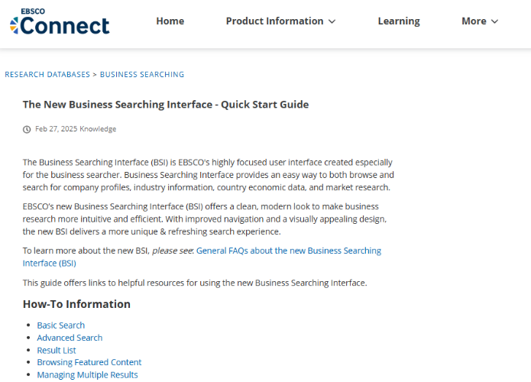
  For more information about using the BSI, click the Help link to view the Business Searching Interface Quick Start Guide on EBSCO Connect.

Slide 18


